Slide 1
Accumulated Stability Voting: A Robust Descriptor from Descriptors of Multiple Scales
Fred Xu, Matthew Kim, Minh Quan
Yang, T.-Y., Lin, Y.-Y. & Chuang, Y.-Y., “Accumulated Stability Voting: A Robust Descriptor from Descriptors of Multiple Scales,” in Proc. IEEE Conf. on Computer Vision and Pattern Recognition (CVPR), Las Vegas, NV, USA, Jun.–Jul. 2016, pp. 327-335. doi:10.1109/CVPR.2016.42.

Slide 2
Agenda
Introduction & Problem Statement
Methodology & Design
Results & Analysis
Conclusion
Project Proposal

Slide 3
Introduction & Problem Statement
Problem: Most traditional descriptors describe features at a single scale determined by the detector. Incorrect scale selection can lead to unstable feature matching, possibly classifying noise to be features at a certain scale.
Goal: Develop a descriptor that integrates information from multiple scales to enhance robustness against scale variations.
Contribution:
Introduce the overall design of the ASV framework.
Apply the principle of maximum entropy to determine optimal thresholds for stability quantization.
Provide both real-valued and binary versions of ASV.

Slide 4
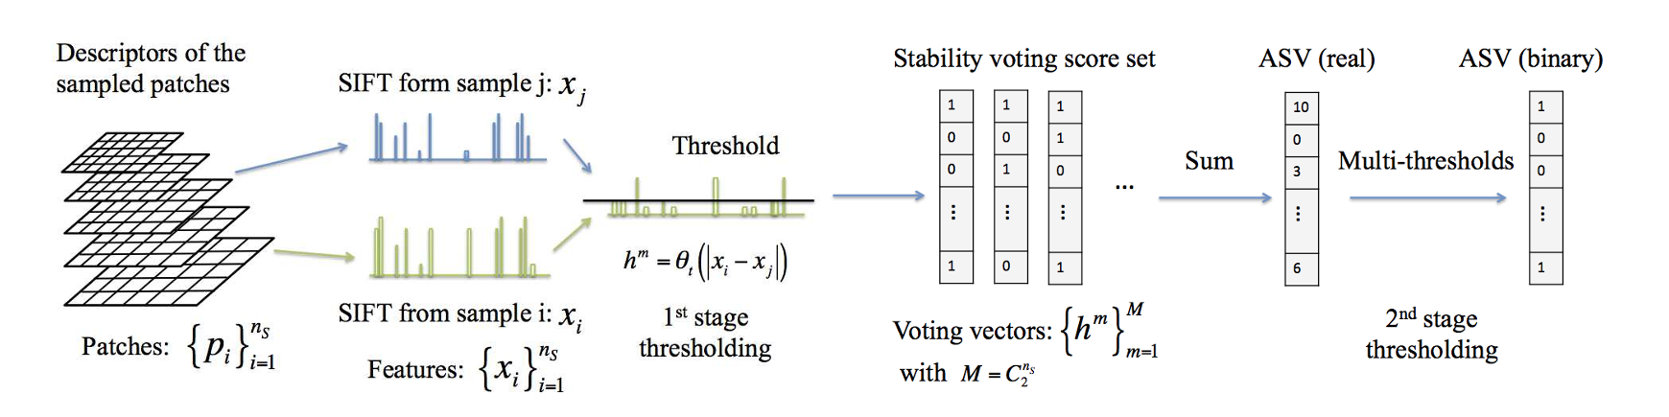
ASV Design
Key Idea: Assess the stability of each descriptor dimension across scales and aggregate this information into a single descriptor.
Notes:
ASV Framework:
Sampling: Extract baseline descriptors at several nearby scales around the detected scale. Used Feature interpolation to double sample size without generating additional computational cost.
Stability Measurement: Compute the absolute difference between pairs of descriptors at different scales. (stability vector) measures how much each of the 128 descriptor elements change in terms of magnitude between two scale.
Voting: Apply thresholding to classify each descriptor bin as stable or unstable.
Accumulation: Sum stability votes across all scale pairs to produce a real-valued descriptor (ASV-SIFT). Each element in the descriptor counts how many times that feature dimension was stable across different scale pairs. High score -> consistently stable.
Quantization: Apply an additional thresholding stage to generate a binary descriptor for efficient storage and matching.

Slide 5
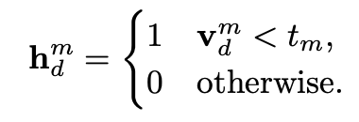
ASV Details: Voting Thresholds
Threshold: Determine whether a descriptor element is stable or unstable
Single threshold:
Determine a threshold for each scale pair as the median of values (∈ [1.. 128]) in scale pair v^{m}
The entropy is maximized when the number of 1s equals the number of 0s.
Multiple thresholds (optional):
Extend thresholding to multiple levels
Very stable elements get lots of votes
Thresholds are determined dynamically using the maximum entropy principle.
0 | 0 | 1 | 2 | 3 | 4 | 5 | 5 | 6
Multiple thresholding example (n_{t} = 2)
Notes:
Multiple thresholding: Define multiple thresholds within each scale pair and count the votes against each level. Sum all votes to generate the real value of each descriptor.

Slide 6
Binary ASV
Second stage thresholding:
In scenarios where faster matching is needed, a binary version of the ASV descriptor can be generated using second stage thresholding on the votes:
Choose a number of thresholds n_{t}
Divide the range [0, max_votes] into n_{t} + 1 equal intervals.
Quantize accordingly.
The resulting binary ASV-SIFT achieves a strong balance between speed, memory, and accuracy.

Slide 7
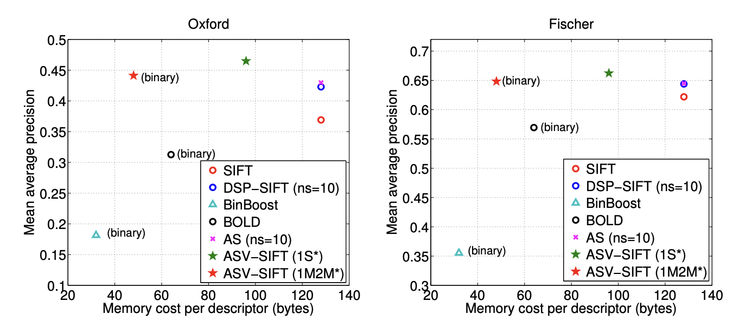
Evaluation & Analysis
Evaluation
Oxford Affine Covariant Regions – viewpoint, scale, illumination changes
Fischer dataset – geometric/photometric variations
SYM dataset – controlled distortions (synthetic)
Metrics
Mean Average Precision (mAP)
Precision–Recall (PR)
Descriptor size (bits) – real vs binary variants
Qualitative matching – match visualizations.
Method | Oxford (mAP) | Fischer (mAP) | Gain vs SIFT
SIFT (baseline) | 0.37 | 0.62 | —
ASV-SIFT (real) | 0.47 | 0.66 | +28% / +7%
ASV-SIFT (binary) | 0.44 | 0.65 | +19% / +4%
Source: Yang et al., “Accumulated Stability Voting: A Robust Descriptor from Descriptors of Multiple Scales,” CVPR 2016, Tables 1–3 (pp. 331–332).

Slide 8
Evaluation & Analysis
Strengths
Multi-scale stability aggregation improves descriptor robustness
Real ASV-SIFT achieves highest mAP among all handcrafted descriptors
Binary ASV-SIFT → compact but high-performing alternative
PR curves show consistent improvements across datasets
Analysis
Largest gains occur under strong scale and illumination variation
ASV smooths out descriptor instability by integrating cross-scale votes
Improvement is not dataset-specific → indicates broad robustness
Limitations / Gaps
Uses global maximum-entropy threshold, not adaptive
No GPU/runtime breakdown beyond “moderate overhead”
Evaluated on classical datasets, not modern large-scale sets

Slide 9
Conclusion
New feature descriptor
ASV calculates the stability of a feature across multiple scales to generate a feature descriptor
Improved feature descriptor
Real-valued ASV achieves the best matching accuracy
Binary ASV-SIFT offers good matching performance with low storage costs.
Lightweight feature descriptor
The framework is training-free, simple to implement, and highly effective in diverse conditions.

Slide 10
Group Project
Replication
Implement ASV in OpenCV
Compatible with multiple feature detectors
Evaluation
Mean average precision
Runtime performance: vs SIFT and BRISK
Robustness: performance against blur, noise, brightness
Improvement
Study thresholding strategies: adaptive/weighted voting

Slide 11
Q & A

